Slide 1
The Scene of the Smoke …
Notes:
Danbury is at the top of the map. The British came north from Norwalk, at the bottom, through Reading. When they left, they went south through Ridgefield, where the battle took place.

Slide 2
Brigadier General Samuel Holden Parsons, 22 April 1777
To General George Washington
Sir:
The Detachments marched from the several Regiments in this State
are less than I expected owing to a Variety of unforeseen Accidents—
I have heard Nothing from your Excellency since the 3d of April;
I should be glad to receive your Excellency’s Directions about clothing
the Troops…
Notes:
Maybe you can hear a sarcastic tone in Gen. Parson’s note. He was that in in Danbury, where he presided at the trial of a spy. The “unforeseen accidents” were the recruit prospects finding out that being a soldier in the war was not a free ride/free horse/free uniform/free gun OR free food.

Slide 3
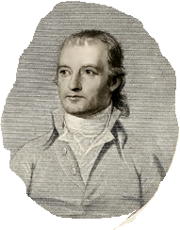
Col. Jedediah Huntington to Gen. Washington
15 April 1777
Since the Date of your Letter, the Governor & Council have resolved
forthwith to make a Draft of Men to fill up the continental Battalions --
equiping the Men is attended with the utmost
Difficulty, with Blankets in particular—praying & paying hardly prevail
with Families to spare from their already exhausted Stores—
Notes:
And so we arrive at the point where “choice to be a soldier” changes over to “forced to be a soldier.” Connecticut got strict.
I love the expression, “paying and praying!” In the last slide we saw a general have an issue with uniforms: here a famous colonel voices an issue with blankets. How did family stores become so exhausted? The magic word was “confiscation.” As we move into the book, the cloth problem expands.

Slide 4
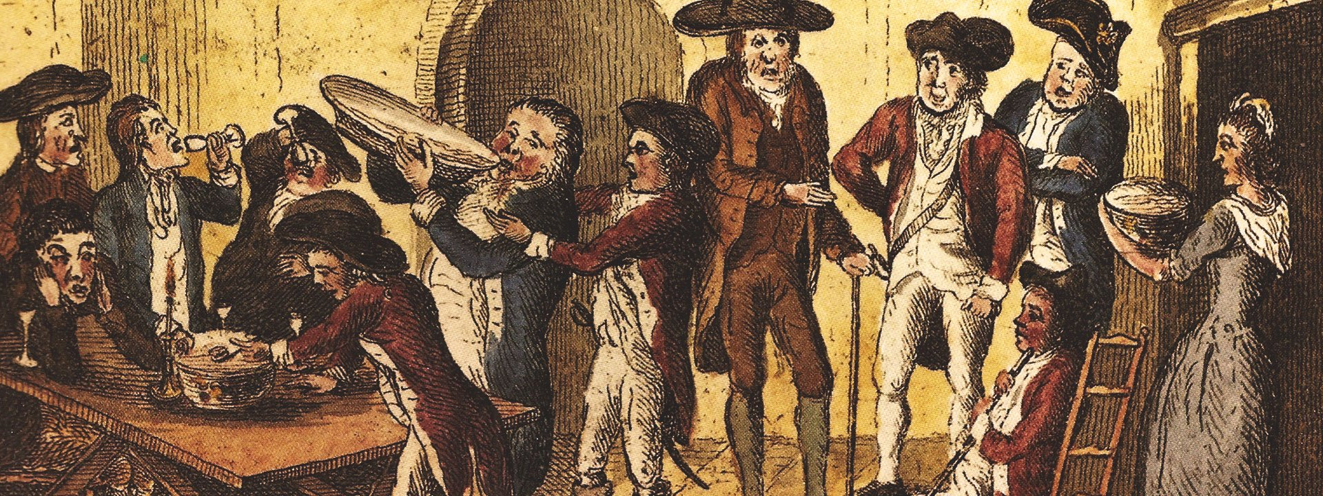
Notes:
How to get recruits? Pay them upfront money along with food and drink. And then you had them sign the papers….

Slide 5
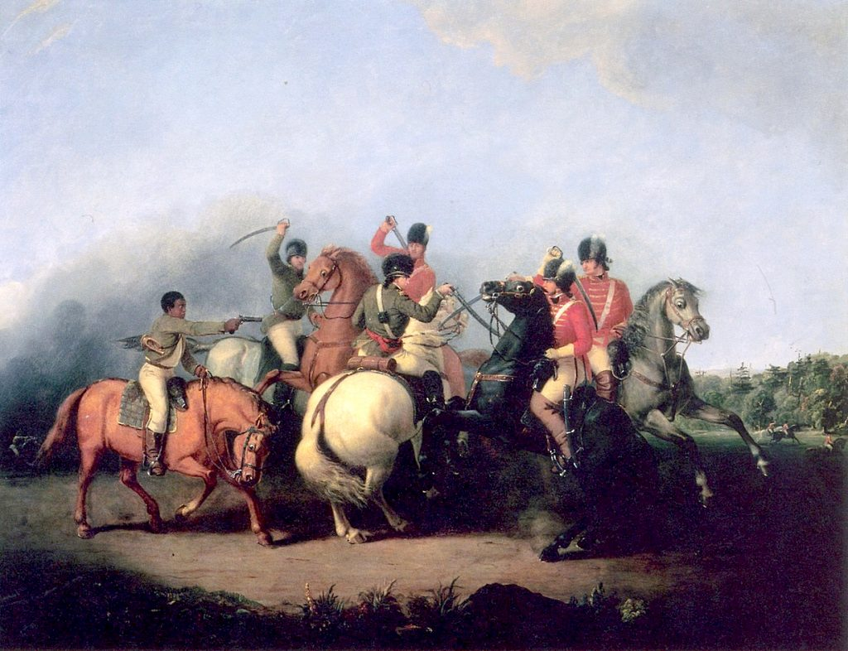
A source of British moral disapproval of Colonists was slavery, which was illegal in England.
The issue was whether the colonies should be forced to follow the laws of England.
After Lord Dunsmore’s proclamation of
freedom for slaves who joined the
British army, the patriots offered
freedom, too.
This young man may have come with
the wrong weapon – 2 bullets at most!
Notes:
Pretty cute pony that boy is riding!

Slide 6
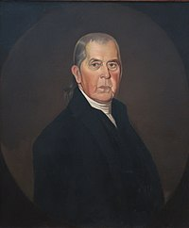
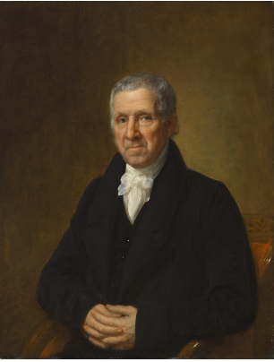
Cobbler
Mayor
Colonel
Spy
Judge
Notes:
Here are two gentlemen from Danbury. One is a cobbler and one is a judge. One is a spy and one is a Patriot Colonel, as well as mayor of Danbury. One is a county probate judge and one is a justice of the peace. Care to guess? Col. Joseph Platt Cooke of Danbury on the left. Notorious spy Enoch Crosby on the right. One has his portrait in the National Portrait Gallery in Washington DC. Only one of them is a hero – you’ll have to wait and see who it was!

Slide 7
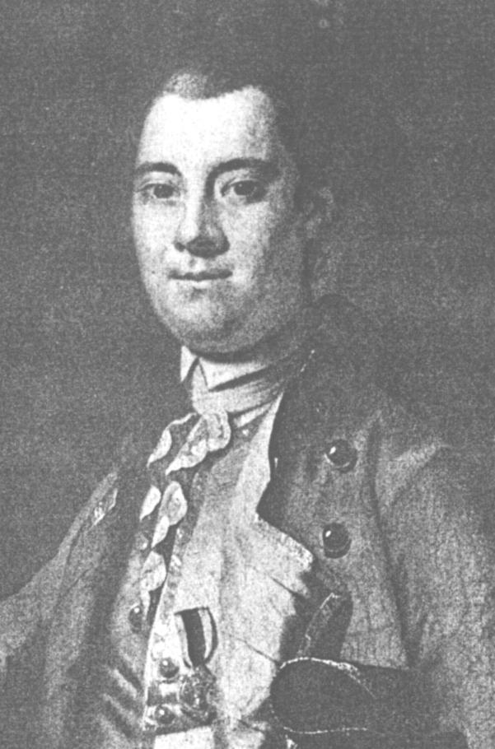
Governor William Tryon
He had a reputation of being a nice person – if he liked you.
Fortunate indeed for one of my book’s characters that he already knew former Governor Tryon.
Notes:
Let’s mee the “enemy,” except these were the persons on the right side of the law at the time. General Tryon had been governor of New York. Because he had been in Connecticut before, he went with two British general as an escort. He said where to go, although the British generals were in command of the troops.

Slide 8
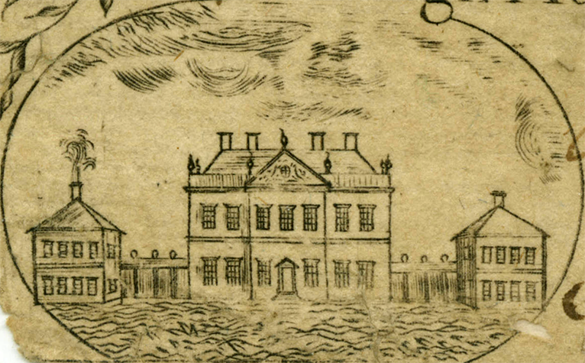
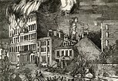
Tryon loved designing classical buildings. As governor, his palatial home functioned also as the seat of NC government.
Alas, it burned.
Tryon’s hard-line governing led to relocation to NY.
Oops – it happened again …maybe the Liberty Boys.
Notes:
Gen. Tryon had been governor of North Caroline before and built this lovely site. The people hated him for his administration of taxes that even he admitted were unfair but were government policy.

Slide 9
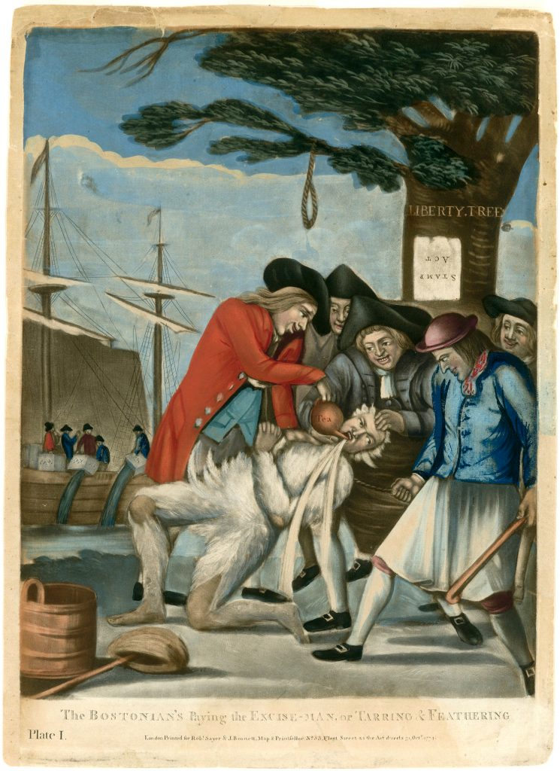
The Liberty Boys were thugs-for-hire and DYI smash-and-burn bandits. Torchlight processions led to stuff – bad stuff.
This was England’s first experience with mob rule. They found it very scary that in daylight, one had no idea who had done what.
Notes:
Patriot mobs did many bad things, despite orders that smash-and-burn was not an approved policy.

Slide 10
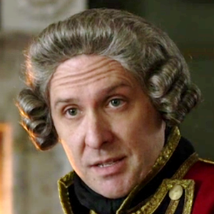
Now starring in “OUTLANDER”
(Season 4, anyway…)
Sir William Tryon!
And his house in New Berne!
Notes:
Here’s the actor who portrays Gen. Tryon on Outlander. His home was rebuilt in the 1950s and is a tourist attraction like Williamsburg!

Slide 11
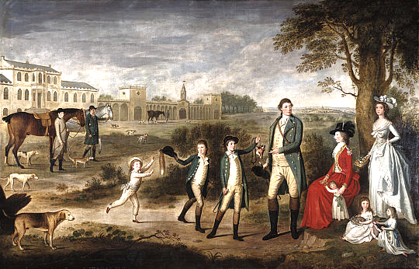
Sir William Erskine and His Family
“Houses here look all the same to me, just wood,” answered General Agnew, perhaps more accustomed to castles.”
Notes:
General Erskine was one of the British Generals. Looks like his family just returned from fox-hunting. I like how his favorite dog and horses are in the picture, too.

Slide 12
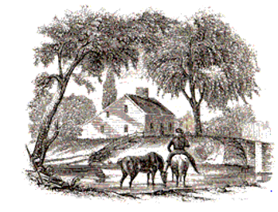
Home of Mr. Benjamin Knapp and Wife
Sarah, Mercy, Noah and Urania
Corner of Barren Plain Road (now White Street)
at the Still River Bridge on Town Street (now Main Street)
Notes:
Here is the house in Danbury where much of the action takes place. This drawing is from 1840.

Slide 13
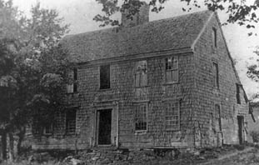
Home of Nehemiah Dibble (Dec’d)
Residing there in 1777:
Mr. Joseph Dibble, son
(or anyone else who comes along)
May 1. Went with Herrick and others to ketch Isaac Read, a Tory, that had broke
from guard at Fishkill], and just after the moon did rise they came, and we searched
the house but could not find him, and then we came to Joseph Dibbel’s and took him
and Daniel and searched two more houses and found nobody and then we came
back to Ezra Dibbel’s and had some West India, and then I with five others
did search Glover’s house and Dibbel’s Mill.
Notes:
This is another house in the story, taken over by whoever ran in there. Joseph Dibble lived here at the time of the story. See how its shape is the same as the Knapp house. That’s important to our character, Joe Hamilton.

Slide 14
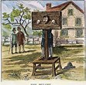
Notes:
Yes, criminals were on both sides. The Liberty boys used criminal acts, but criminals did them, too!

Slide 15
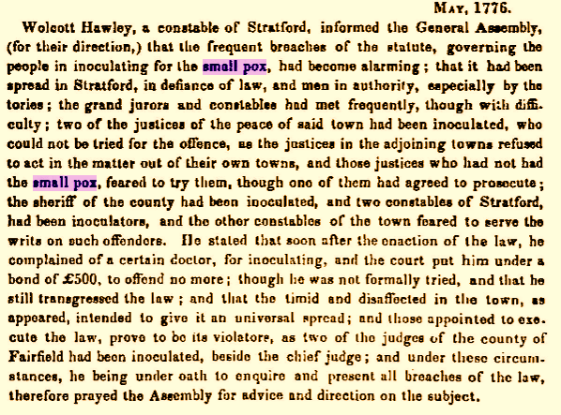
Smallpox
Notes:
We talk about the flu and the Corona virus, but smallpox was unbelievably worse. This poor constable has no idea what to do when sheriff and judges do inoculation, even though it was illegal!

Slide 16
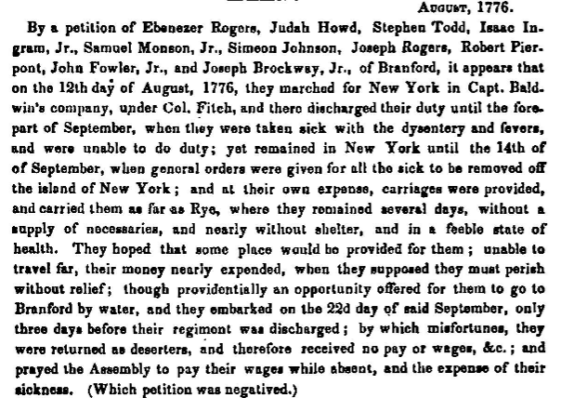
Notes:
Here’s another reason men were not anxious to join the army: if you got sick, that was fully and completely your own problem. Someone did offer to help these men, but in the next slide, you’ll see where that could lead. Nowhere good.

Slide 17
In 1777, more than one hundred thousand people in North America died as a result of smallpox epidemics.
Washington made the controversial decision to have his soldiers inoculated in February of ’77. In March, the military hospital in Danbury opened.
Notes:
In the book, we follow some refugees from the disaster of Ft. Washington.

Slide 18
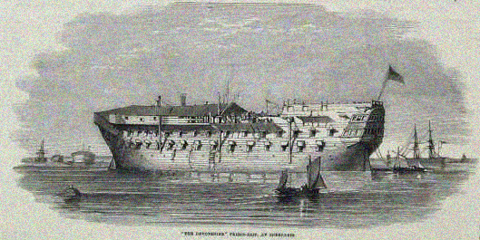
Some estimate 18,000 soldiers, sailors AND hapless civilians were liquidated on the infamous British prison ships and in New York prisons - against 4,300 killed in the American armed forces during the entire war.
Notes:
Another person in the book suffers this fate after the fall of Ft. Washington.

Slide 19
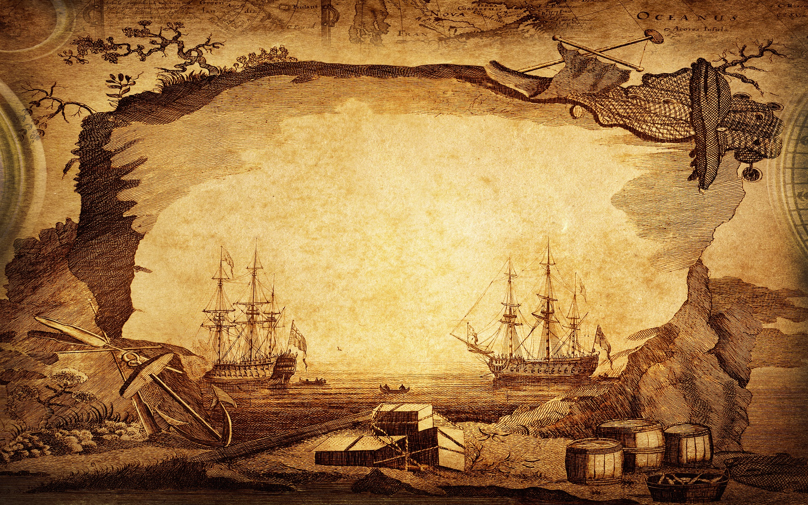
(Of the 2700 men taken captive at Fort Washington in November 1776, 1100 died over the winter and another 900 on the way home after they were let go – an effective mortality rate of almost 75 percent.)
Of the 2700 men taken captive at Fort Washington in November 1776,
1100 died over the winter and another 900 on the way home after release
– a mortality rate of almost 75 percent. The mortality rate at Andersonville
was around 35%. Of the 19 Danbury men captured, the survivors were 3.
An observer reported the Long Island shore as
“skulls lying as thick as pumpkins
in an autumn cornfield."
Notes:
Explain that Andersonville was the worst prison in the Civil War.

Slide 20
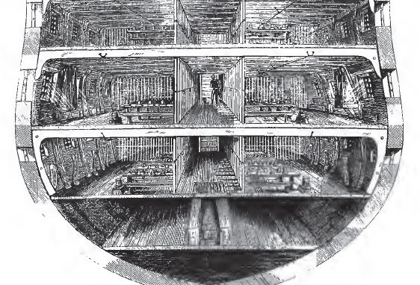
Notes:
Inside of a prison ship.

Slide 21
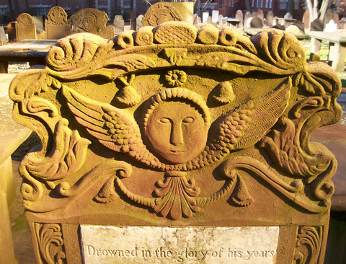
Eventually, "near twenty hogsheads full of bones were collected by the indefatigable industry of John Jackson, esq.”
In 1808, the remains of the prison ship martyrs were buried in a tomb near the Brooklyn Navy Yard.
Notes:
The dead would be dumped in the water or buried on Long Island. The residents complained hot and heavy, until this resolution.

Slide 22
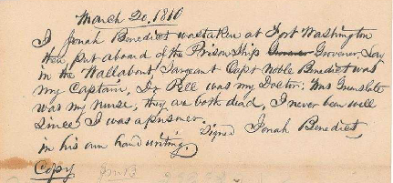
…. Taken ….
Notes:
Note from a person whom we will meet later.

Slide 23
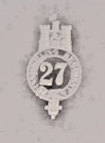
Sat. 24th Dec. Bad day; constant snow till evening, when it turned out rain and sleet. A Soldier of the 10th shot for desertion; the only thing done in remembrance of Christ-Mass day.
A British Officer’s Diary
In memoriam: Thomas Flynn, both the real and imagined….
Notes:
Here is another person you will meet in the book. If you were a deserter, how would you do it?

